Slide 1




STOCK MARKET ANALYSIS

Slide 2
Index :
KPI’S Observation
Dashboards
Challenges & how we face it

Slide 3
KPI’S Observation
1. Average Daily Shares Traded
Facebook has the highest, while Apple has the lowest daily shares traded among the selected stocks.
2. Most Volatile Stocks
Apple exhibits higher volatility by beta value compared to Amazon.
3. Total PE Ratio by Stock
Apple holds the highest PE ratio, while Facebook has a lower PE ratio.
4. Stocks with Dividend Amounts
Microsoft offers the highest dividend amount.
5. Total Market Cap
Microsoft has the highest market cap, signifying greater size and significance.

Slide 4
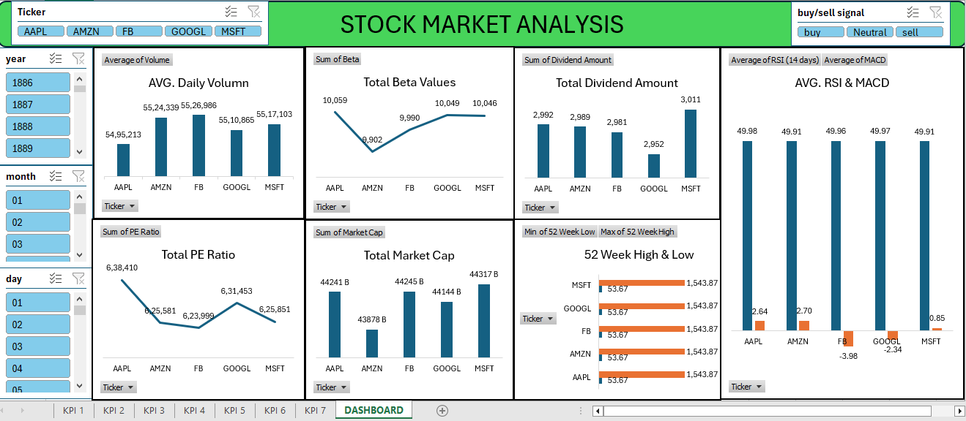
Excel Dashboard

Slide 5
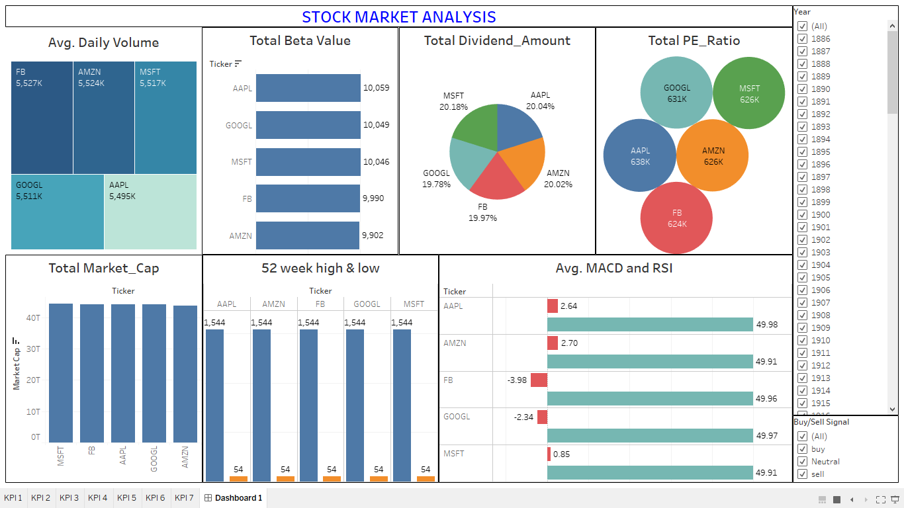
Tableau Dashboard

Slide 6
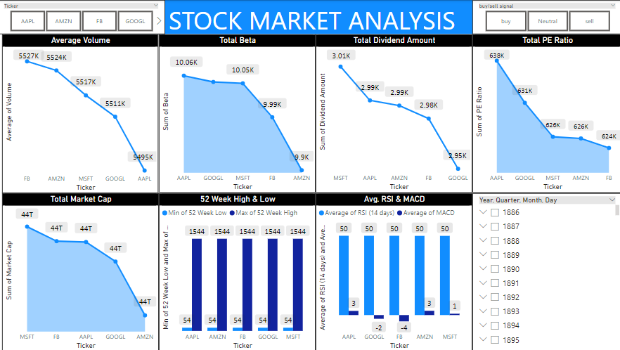
Power BI dashboard

Slide 7
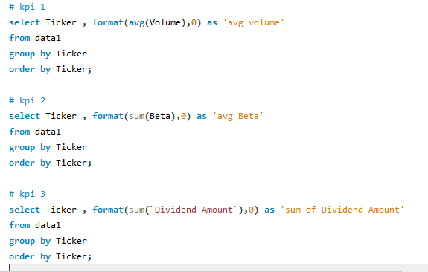
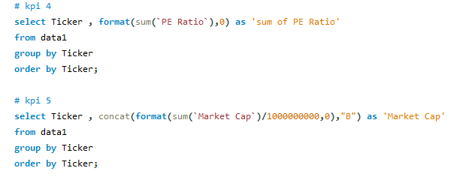
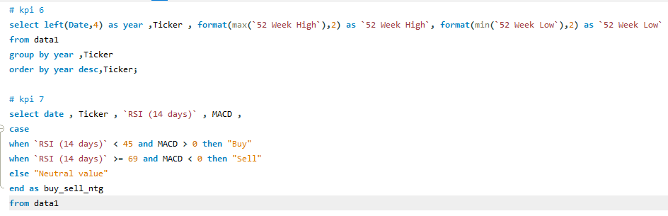
MySQL

Slide 8
Challenges & how we face it
challenge : converting dates before 1900 .
Managing the challenge: Dealing with date format limitations by using text functions to carefully pull out and arrange the year, month, and day separately.

Slide 9
Thank You

